Slide 1


Slide 2


Slide 3
Core NGINX functionality includes - Webserver with high performance and stability - HTTP server capabilities - proxy server - reverse proxy server - load balancer for HTTP, TCP and UDP servers - caching services

Slide 4


The origin
NGINX development began at Rambler.ru by Igor Sysoev to solve c10k problem of concurrently handling ten thousand connections.
High concurrency
Low memory use

Slide 5
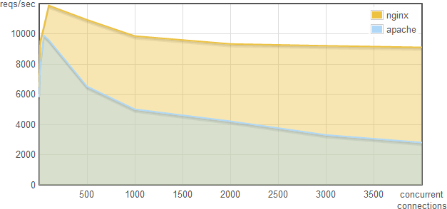
High Concurrency
Source: Webfaction Blog: http://blog.webfaction.com/2008/12/a-­‐little-­‐holiday-­‐present-­‐10000-­‐reqssec-­‐with-­‐nginx-­‐2/

Slide 6
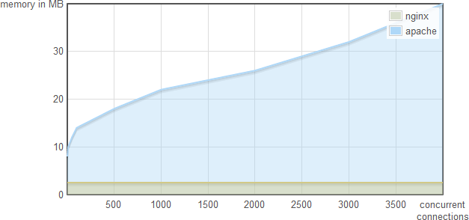
Low Memory Use
Source: Webfaction Blog: http://blog.webfaction.com/2008/12/a-­‐little-­‐holiday-­‐present-­‐10000-­‐reqssec-­‐with-­‐nginx-­‐2/

Slide 7




Apache is like Microsoft Word, it has a million options but you only need six. Nginx does those six things, and it does five of them 50 times faster than Apache.
- Chris Lea
(Director of Software Engineering at Salesforce)
Learn more at nginx.com

Slide 8
Installation

Slide 9

Traditional Installation
$ wget http://nginx.org/keys/nginx_signing.key
$ sudo apt-key add nginx_signing.key
# cat > /etc/apt/sources.list.d/nginx.list
deb http://nginx.org/packages/mainline/ubuntu/ trusty nginx
deb-src http://nginx.org/packages/mainline/ubuntu/ trusty nginx
# apt-get update
# apt-cache policy nginx
nginx:
Installed: (none) Candidate: 1.7.0-1~trusty Version table:
1.7.0-1~trusty 0
500 http://nginx.org/packages/mainline/ubuntu/ trusty/nginx amd64 Packages 1.4.6-1ubuntu3 0
500 http://us.archive.ubuntu.com/ubuntu/ trusty/main amd64 Packages
http://nginx.org/en/linux_packages.html#mainline

Slide 10
Installation at ubuntu 16.04
sudo apt-get update
sudo apt -y install nginx
service nginx status
http://nginx.org/en/linux_packages.html#mainline

Slide 11

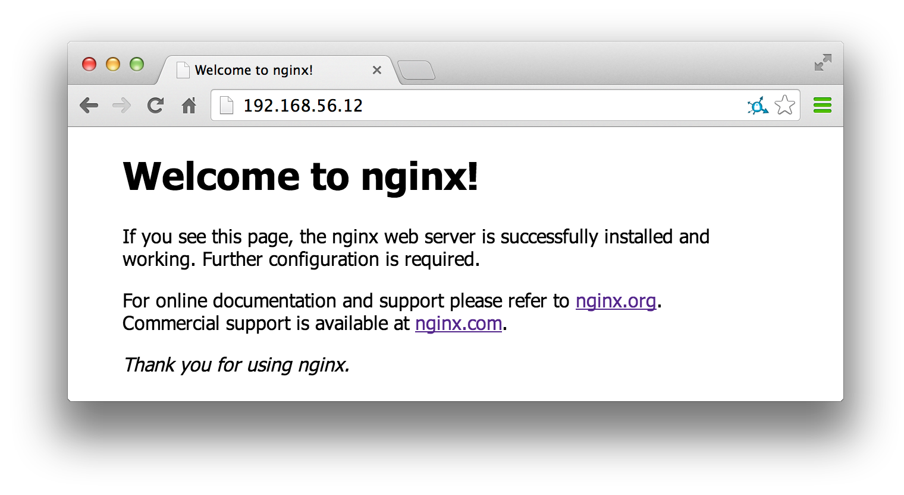
Verify it’s working
# /etc/init.d/nginx status
* nginx is running
# /usr/sbin/nginx –v
nginx version: nginx/1.7.0

Slide 12

The basic components

Slide 13
Where are the things
NGINX executable is at /usr/sbin/nginx
Conﬁguration ﬁles at /etc/nginx
Log ﬁles at /var/log/nginx

Slide 14
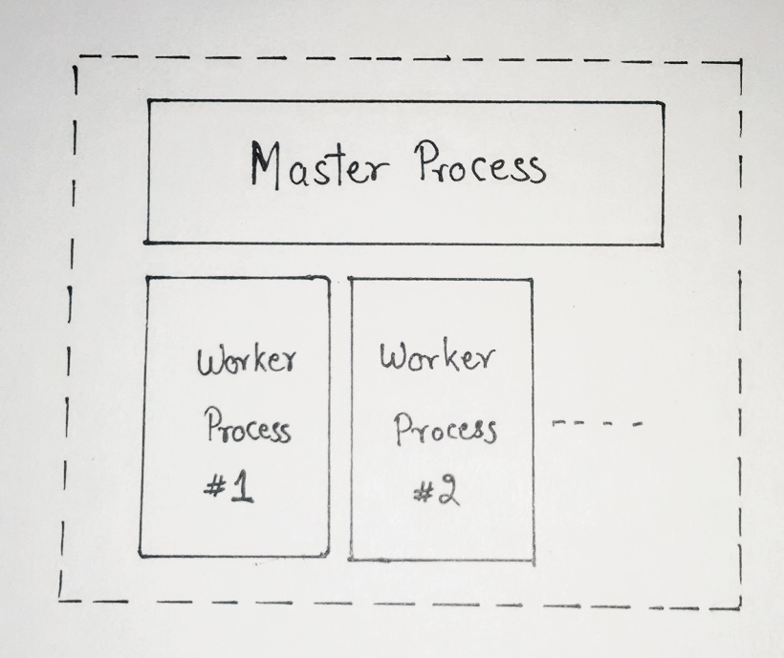
NGINX processes
One master process and many worker processes
The master process evaluates the conﬁguration ﬁle and manages the worker processes
Worker processes handle actual requests
[root@localhost ~]# ps -ef |grep nginx
root | 1991 | 1 | 0 | 08:06 ? | 00:00:00 nginx: | master
process /usr/sbin/nginx -c /etc/nginx/nginx.conf
nginx process | 2974 | 1991 | 0 | 08:22 ? | 00:00:00 nginx: | worker
nginx process | 2975 | 1991 | 0 | 08:22 ? | 00:00:00 nginx: | worker

Slide 15
Basic NGINX commands
To start NGINX, simply run the executable ﬁle at /usr/sbin/nginx
The executable can be run with “-s” parameter followed by a signal.
Reload conﬁguration
nginx –s reload
Graceful shutdown. NGINX will wait for workers to ﬁnish processing requests
nginx –s quit
Fast shutdown
nginx –s stop

Slide 16
Lab : Install Nginx

Slide 17
The NGINX conﬁguration ﬁle
The conﬁguration ﬁle determines how NGINX and its modules behave
The main ﬁle is named nginx.conf and is located in /etc/nginx
The main conﬁguration ﬁle may include references to additional conﬁguration ﬁles
Conﬁguration consists of
Directives
Contexts
Blocks

Slide 18
Conﬁguration directives

Slide 19
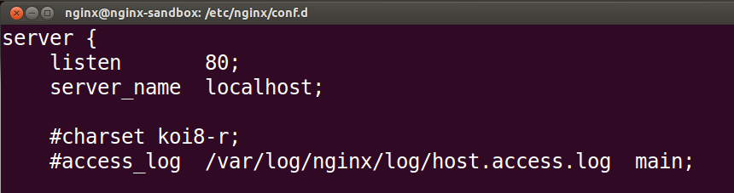
Directives
A Directive is a conﬁguration statement that controls the behaviour of NGINX modules
Consists of the directive name, followed by parameters and ends in a semicolon
Two types of directives
Simple directive
Block directive
Simple directive

Slide 20
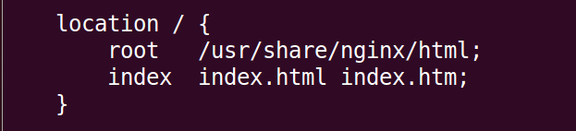
A Block Directive is a directive that contains multiple conﬁguration instructions
The conﬁgurations instructions inside a block directive are surrounded by braces i.e. { }
Block directive

Slide 21
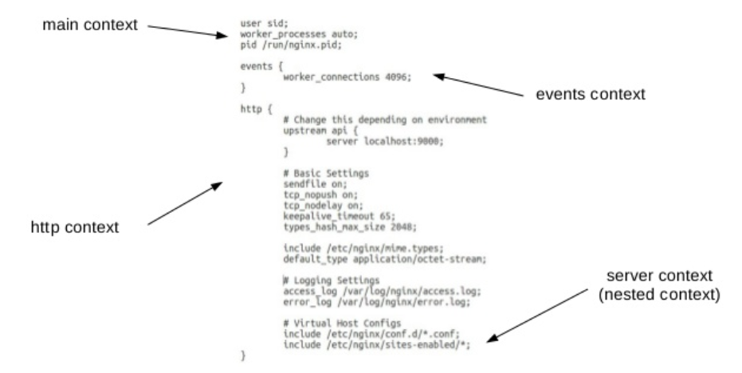
Contexts
hierarchical structure to create discrete configuration of blocks.

Slide 22
Lab : Nginx basic configuration

Slide 23
Specify the Server Block
The Server block deﬁnes the conﬁguration for a virtual server
Goes inside the HTTP context
Can contain a listen directive, server_name
directive and root directive
Can specify many server blocks
Equivalent to VirtualHost in Apache

Slide 24
Specify the Server Block
The Server block deﬁnes the conﬁguration for a virtual server
NGINX will choose which server to process a request based on the server name and the listen port
Define a virtual server that listens for requests on port 80
http {
server {
listen 80;
}
}

Slide 25
Location Block
The location block deﬁnes the conﬁguration that will apply based on a matching request URI
Placed inside a server block.
Server block can contain many location blocks.
Can contain a Root directive, which will override the Root directive of the server.
Can be nested inside a location block.
Two types of location blocks
Preﬁx location + Regex location

Slide 26
Example Server and Location
Root directive sets the root directory for a request.
A request to localhost:8080 will return the
index.html ﬁle in /home/nginx/public_html as below.
server {
listen 8080;
root /home/nginx/public_html; location /application1 {
}
location /images/ { root /data;
}
}

Slide 27
Lab : Nginx configuration for directives and location

Slide 28
The Include directive
The include directive allows you to include additional conﬁguration ﬁles.
Syntax: include <path to file>;
Best Practices:
For each server, create a separate conﬁguration ﬁle in /etc/nginx/conf.d
nginx.conf includes all ﬁles in the conf.d folder ending in .conf by default
Similarly, we can include
/etc/nginx/sites-enabled/*

Slide 29
Deﬁning server names
Use the server_name directive in the server context to deﬁne the names for your server
server {
server_name mycompany.com *.mycompany.com;
}

Slide 30
Lab : Nginx configuration for include directive for sites-enabled

Slide 31
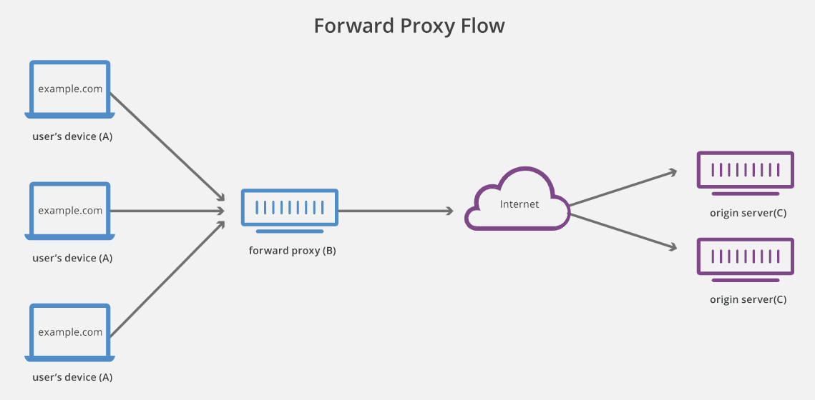
Proxy server (forward proxy)
To protect user’s identity and block contents

Slide 32
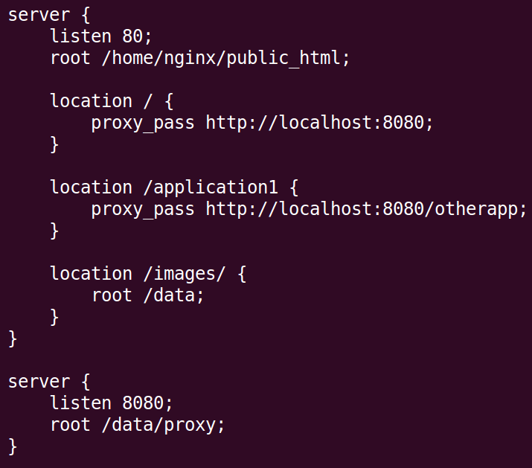
Simple Proxy Scenario and virtual host
Server one listening for requests on port 80 and serves content from /home/nginx/public_html
Server two listens on port 8080 and serves content from /data/proxy
Requests for localhost are proxied over to the server on port 8080

Slide 33
Lab : Nginx configuration as proxy server and virtual host

Slide 34
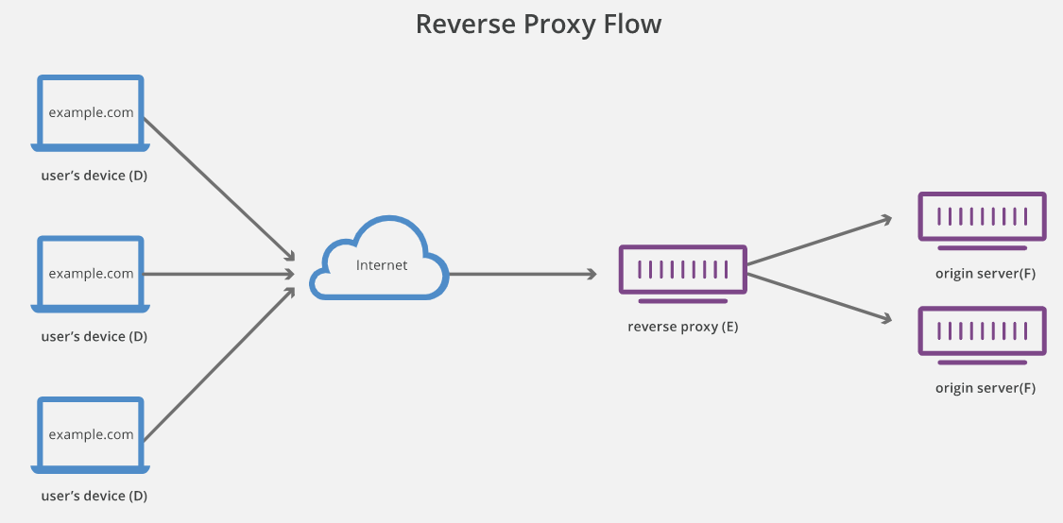
Reverse Proxy server
Load Balancing
Protection from malicious attacks
Caching
High availability
Encryption

Slide 35
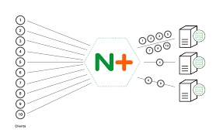
Load Balancing
Techniques used by nginx for load balancing :-
Round-Robin.
Least Connection.
Hashing

Slide 36
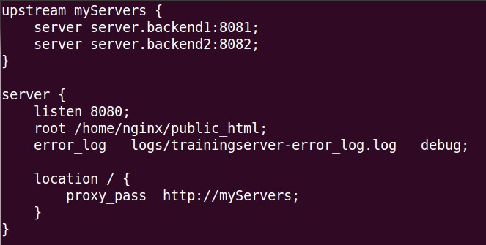
Proxying to the upstream block

Slide 37
Specifying server priorities
By default, all servers deﬁned in the upstream block are treated with equal priority.
Use the weight parameter to indicate a higher or lower weighting for a particular server.
upstream myServers {
server backend.server1 weight=5 server backend.server2 weight=3 server backend.server3 weight=2
}

Slide 38
Lab : Reverse proxy

Slide 39


Slide 40
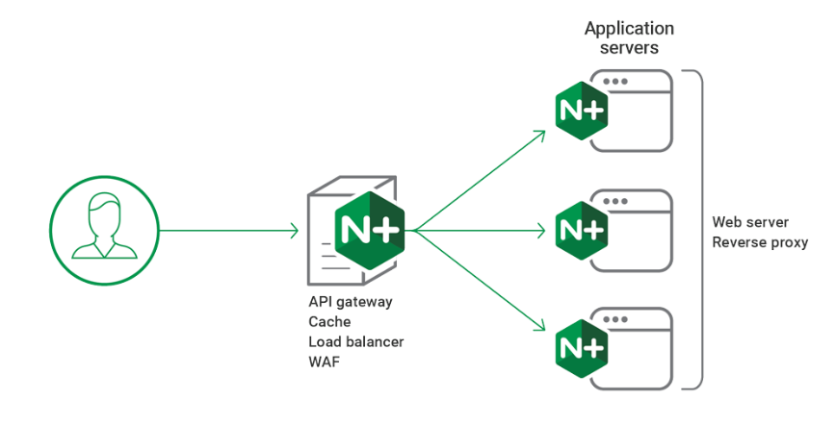
What Is NGINX Plus?
NGINX Plus is a software load balancer, web server, and content cache built on top of open source NGINX.
NGINX Plus has exclusive enterprise‑grade features beyond what's available in the open source offering, including session persistence, configuration via API, and active health checks.

Slide 41
Nginx – Plus Installation
sudo mkdir /etc/ssl/nginx
cd /etc/ssl/nginx
sudo vi nginx-repo.crt # download crt and copy
sudo vi nginx-repo.key # download key and copy
sudo wget https://nginx.org/keys/nginx_signing.key
sudo apt-key add nginx_signing.key
sudo apt-get install apt-transport-https lsb-release ca-certificates
printf "deb https://plus-pkgs.nginx.com/ubuntu `lsb_release -cs` nginx-plus\n" | sudo tee /etc/apt/sources.list.d/nginx-plus.list
sudo wget -q -O /etc/apt/apt.conf.d/90nginx https://cs.nginx.com/static/files/90nginx
sudo apt-get update
sudo apt-get install -y nginx-plus
service nginx status
nginx -v
service nginx start

Slide 42
Nginx Plus API & HTTP Authentication
NGINX and NGINX Plus can authenticate each request to your website with an external server or service.
To perform authentication, NGINX makes an HTTP request to an external server where the request is verified.

Slide 43
Lab : Nginx Plus API & HTTP Authentication

Slide 44
Nginx Plus – Health Check

Slide 45
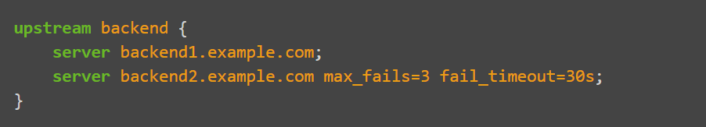
Nginx Plus – Health Check
Passive health checks
For passive health checks, NGINX and NGINX Plus monitor transactions as they happen, and try to resume failed connections. If the transaction still cannot be resumed, NGINX Open Source and NGINX Plus mark the server as unavailable and temporarily stop sending requests to it until it is marked active again.

Slide 46
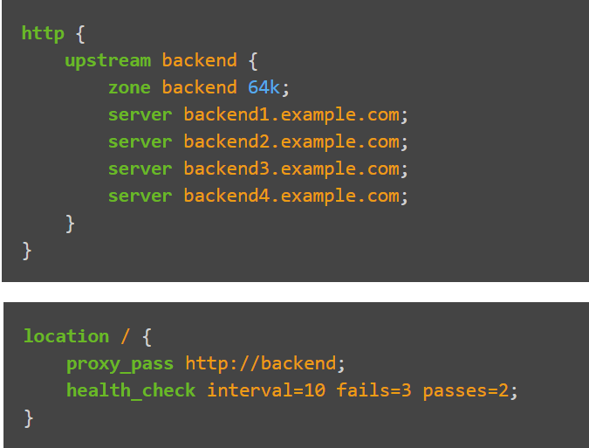
Nginx Plus – Health Check
Active health checks
NGINX Plus can periodically check the health of upstream servers by sending special health‑check requests to each server and verifying the correct response.

Slide 47
Lab – Health Check

Slide 48
Nginx Plus - Encryption

Slide 49
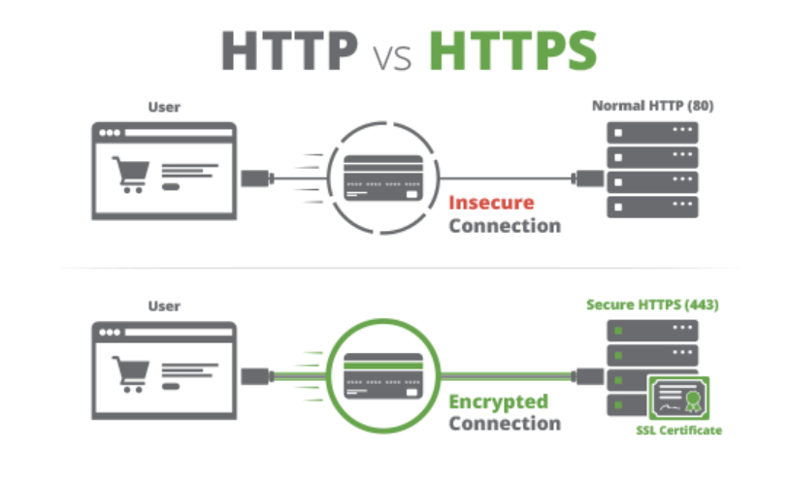

Slide 50
Conﬁguring a HTTPS server
Enable SSL by specifying the SSL parameter on the listen directive
Specify the path of your SSL server certiﬁcate and private key
server {
listen 443 ssl;
server_name training.secure.com;
ssl_certificate /etc/nginx/certs/nginxtraining.crt ssl_certificate_key /etc/nginx/certs/nginxtraining.key
]

Slide 51
Lab – Encryption using SSL

Slide 52
Nginx Plus – Performance Tuning Practices

Slide 53
1. SSL session cache
Performance Tuning Practices
SSL sessions can be stored in a cache and reused in order to avoid having to perform a “handshake” as part of subsequent connections
Reduces the amount of CPU intensive operations on the server
The session cache can be shared between workers
Cache will timeout after 5 minutes by default, but this can be conﬁgured with the ssl_session_timeout directive

Slide 54
Session cache example
Performance Tuning Practices
Syntax
ssl_session_cache shared:<name>:size;
Size is speciﬁed in bytes or megabytes
1 MB store around 4000 sessions
Can speciﬁed in the http or server context
Example
http {
ssl_session_cache shared:ssl:10m; ssl_session_timeout 10m;
server {
listen 443 ssl;
...

Slide 55
2. Enable gzip compression
Performance Tuning Practices
Gzip is a great way to optimize your Nginx server as well to make things even more efficient. There are a few simple steps to turn on Gzip within your Nginx environment.
gzip on;
gzip_types text/plain text/xml text/css application/x-javascript;

Slide 56
3. Optimized Logging
Performance Tuning Practices
The error_log directive can be used to conﬁgure the logging settings.
Syntax:
error_log <file> <log level>;
Can be used in the main, server, http and location contexts.
The Log level speciﬁes how detailed the log output will be
Example
error_log
logs/error.log info;

Slide 57
Logging best practices
Performance Tuning Practices
Should keep a separate error log ﬁle for each server
Helps to reduce size of each log ﬁle and makes troubleshooting easier.
server {
server_name server1.com;
root /data/server1.com;
error_log logs/server1.error.log
}
info;
server {
server_name server2.com root /data/server2.com;
error_log logs/server2.error.log
}
info;

Slide 58
Performance Tuning Practices
4. Reverse proxy and caching
It’s common to use NGINX in front of another web or application server.
NGINX can handle serving all the static content, while requests for dynamic content such as php are proxied to the application server.
Static content can then be cached t o improve performance.
etc/nginx/sites-available/sitename
location ~* \.(jpg|jpeg|png|gif|ico|css|js)$ {
expires 365d;
}

Slide 59
5. Deﬁning the cache path
Performance Tuning Practices
http {
proxy_cache_path /var/cache/nginx levels=1:2 keys_zone=server-cache:8m max_size=1000m inactive=600m;
proxy_temp_path /tmp/nginx;
proxy_cache_path directive to set where to store cached content.
proxy_temp_path directive tells NGINX where to store temporary data which is used to build the cache.
Both directives must be placed in HTTP context.

Slide 60
Deﬁning the cache path
Performance Tuning Practices
proxy_cache_path parameters
keys_zone parameter speciﬁes the name and size of the cache.
max_size parameter speciﬁes the maximum size of the cache.
Inactive parameter speciﬁes how long cached data is kept for if not accessed.

Slide 61
6. Conﬁguring the proxy cache
Performance Tuning Practices
proxy_cache_key directive speciﬁes to use the hostname/subdomain/domain and request URI as the key.
proxy_cache directive deﬁnes the shared memory zone used for caching.
– Name speciﬁed must match the name of the cache deﬁned in the proxy_cache_path directive
Location / {
proxy_pass http://application.com:8080; proxy_cache_key “$scheme$host$request_uri”; proxy_cache server-cache;
proxy_chache_valid 1m; proxy_cache_valid 404 1m;
]

Slide 62
7. Disable access logs
Performance Tuning Practices
Nginx logs each and every action in a log file named “access.log.” If you don’t require this information then it’s preferable to disable it, which will save your environment a bunch of additional processing and hard drive space too. To turn off the logs, simply write condition off next to the access_log syntax as in the following:
access_log off;

Slide 63
8. Adjust work processes
Performance Tuning Practices
Nginx has one master process and several worker processes.
In other words, worker_processes tells your virtual server how many cores are assigned to each processor so that Nginx can manage the concurrent requests in an optimized way.
To find out how many processors you have in your web server, run the following command.
grep processor /proc/cpuinfo | wc –l or lshw –short –class cpu
In this case, the output number shows 1 core CPU.
Default value of work processes for Nginx is automatically calculated based upon number of core processors. (1 in this case)
worker_processes auto

Slide 64
9. Maximize work connections
Performance Tuning Practices
Worker connections tells worker processes how many clients can be served simultaneously by Nginx.
The default value for this is 768 and the maximum number for the worker connections setting is 1024 and it’s best to use this to get the full potential from Nginx.
worker_connections 1024

Slide 65
Lab – Performance Tuning Practices

Slide 66

Now with more Docker

Slide 67
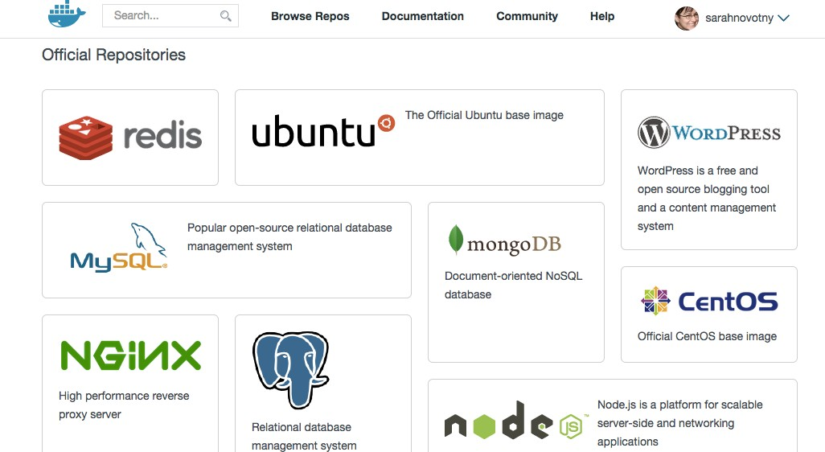
registry.hub.docker.com

Slide 68
Dockerﬁle
FROM debian:wheezy
MAINTAINER NGINX Docker Maintainers "docker-maint@nginx.com"
RUN apt-key adv --keyserver pgp.mit.edu --recv-keys 573BFD6B3D8FBC641079A6ABABF5BD827BD9BF62
RUN echo "deb http://nginx.org/packages/mainline/debian/ wheezy nginx" >> /etc/ apt/sources.list
ENV NGINX_VERSION 1.7.10-1~wheezy
RUN apt-get update && \
apt-get install -y ca-certificates nginx=${NGINX_VERSION} && \
rm -rf /var/lib/apt/lists/*
# forward request and error logs to docker log collector RUN ln -sf /dev/stdout /var/log/nginx/access.log
RUN ln -sf /dev/stderr /var/log/nginx/error.log
VOLUME ["/var/cache/nginx"] EXPOSE 80 443
CMD ["nginx", "-g", "daemon off;"]

Slide 69

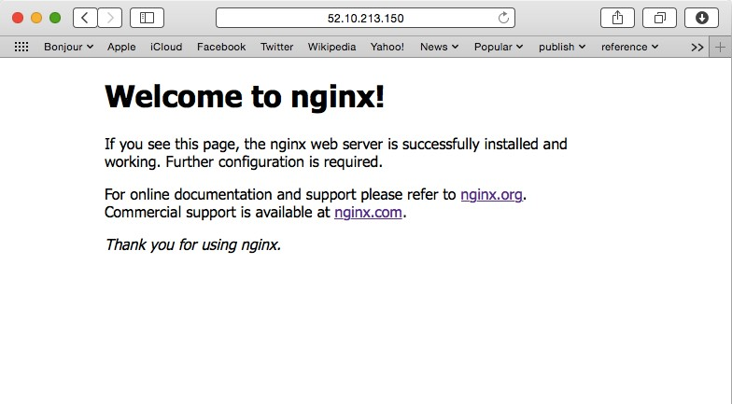
Run our Docker container
$ docker run -P –d nginx ff635ea2653c9489de7037b5c106a26d36f5907e4e75a43f47a3a38029a56b14
# docker ps
CONTAINER ID |  |  | IMAGE | COMMAND |  | CREATED
STATUS |  |  | PORTS |  |  | NAMES
ff635ea2653c |  |  | nginx:latest | "nginx -g 'daemon of |  | 16 seconds ago
Up | 11 | seconds | 0.0.0.0:49153->443/tcp, |  | 0.0.0.0:49154->80/tcp |  | nginx-test
hAps://registry.hub.docker.com/_/nginx/

Slide 70

Exploring our Docker container
$ docker@52.10.213.150 ~: docker run -it nginx /bin/bash
root@74d2a7e93244:/# more /etc/nginx/nginx.conf
user nginx; worker_processes 1;
error_log pid
/var/log/nginx/error.log warn;
/var/run/nginx.pid;
events {
worker_connections
}
1024;
http {
include default_type
/etc/nginx/mime.types; application/octet-stream;
log_format main
'$remote_addr - $remote_user [$time_local] "$request" ' '$status $body_bytes_sent "$http_referer" ' '"$http_user_agent" "$http_x_forwarded_for"’;
…

Slide 71
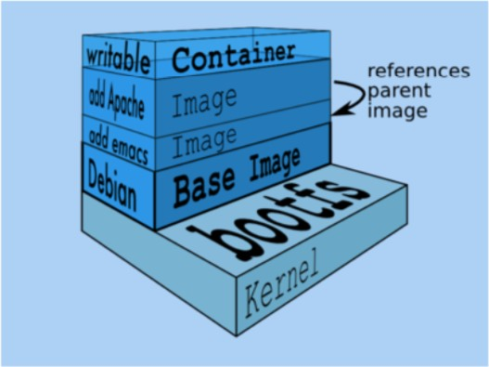
Extending base images in your Dockerﬁle
From @jpettazo’s Docker talk 20150220 #SCaLE13x

Slide 72
Your NGINX Dockerﬁle
FROM nginx
RUN rm /etc/nginx/conf.d/default.conf
RUN rm /etc/nginx/conf.d/example_ssl.conf
COPY static-html-directory /usr/share/nginx/html COPY nginx.conf /etc/nginx/nginx.conf
Fancier options i.e. more repeatable and scalable
Deﬁning VOLUMEs
Using helper containers
Linking containers
http://nginx.com/blog/deploying-­‐nginx-­‐nginx-­‐plus-­‐docker/

Slide 73

@sarahnovotny
Chief Evangelist, NGINX Program Chair, OSCON
Thanks for your time!
http://sarah.is/ExcitedAboutMicroservices

Slide 74


Slide 75


Slide 76


Slide 77


Slide 78


Slide 79


